Slide 1
Recipe Website
GitHub Repository: https://github.com/CloudDCrow/Cooking-Recipes

Slide 2
Purpose
Recipe website for adding recipes and then viewing them
Ability to save recipes on a website and have them stored for future reference
Meant for beginner or home cooks wanting a personalized online cookbook
Simple UI so that people of all ages can understand and use the website efficiently

Slide 3
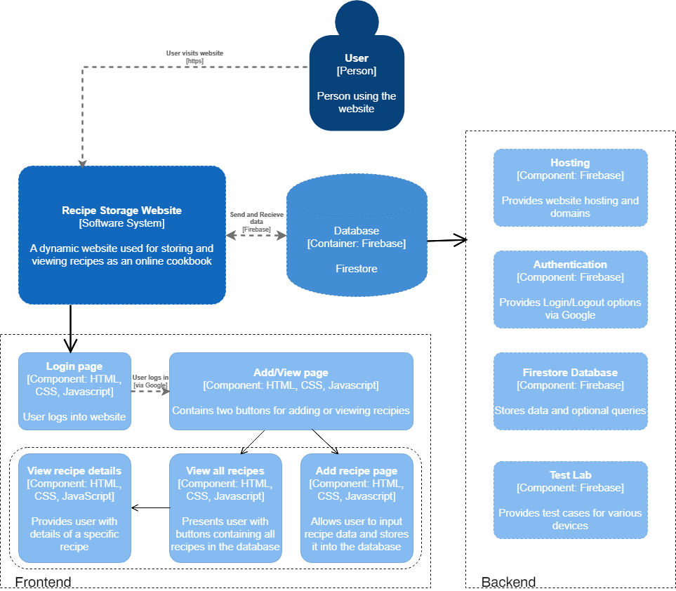
Diagram

Slide 4
Technology Choices
Frontend: HTML, CSS and JavaScript
Backend: Firebase, Firestore, JavaScript
Firebase was chosen because it is very user-friendly, offers free services for small websites, and has many useful futures for building a website

Slide 5
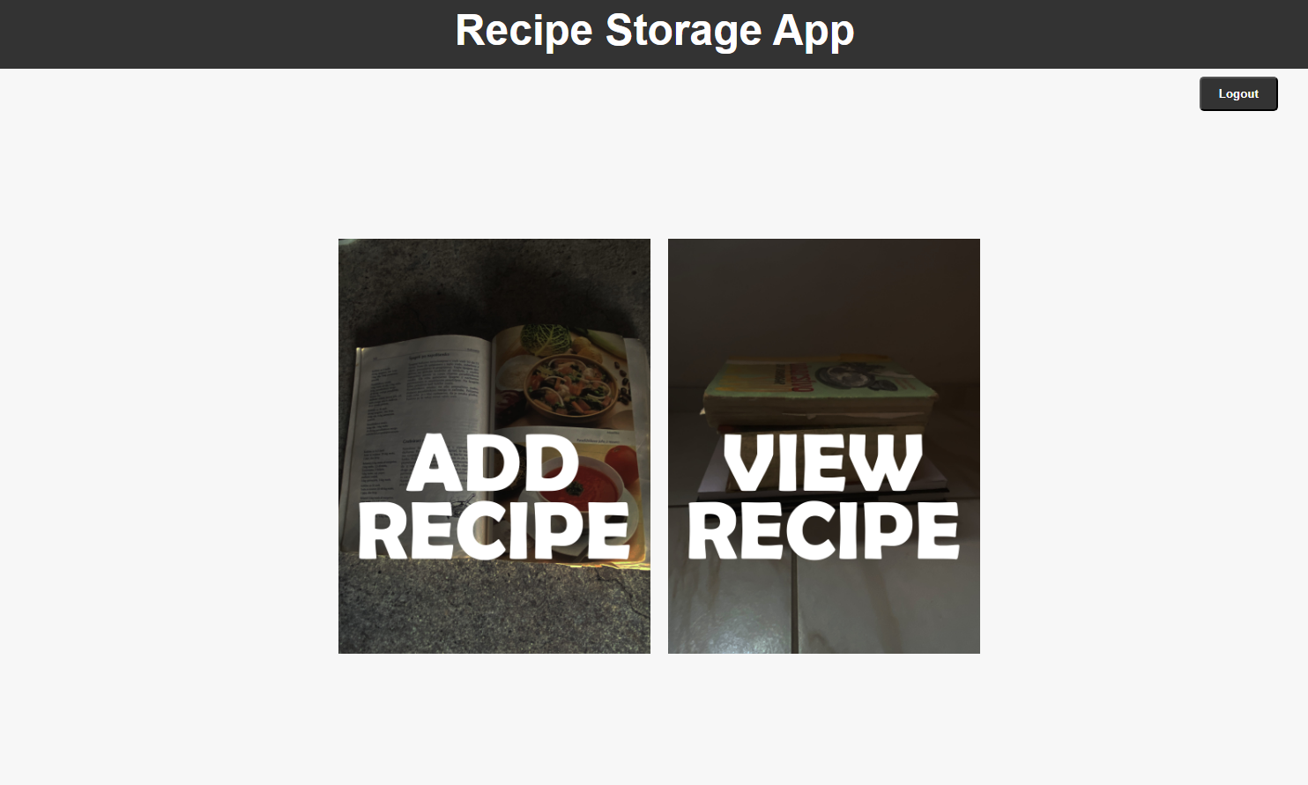
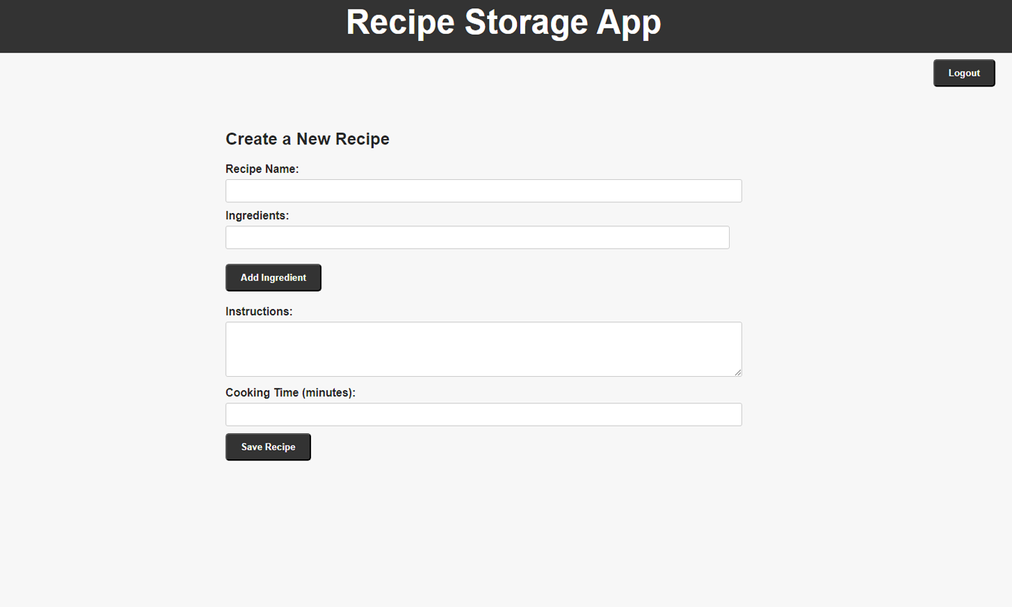
Screenshots
The top screenshot is the home page. It contains two buttons, the first one redirects to the add recipe page, and the second one to the view recipe page.
The bottom screenshot is the add recipe page, where the user can input the desired recipe information like name, ingredients, instructions,…

Slide 6
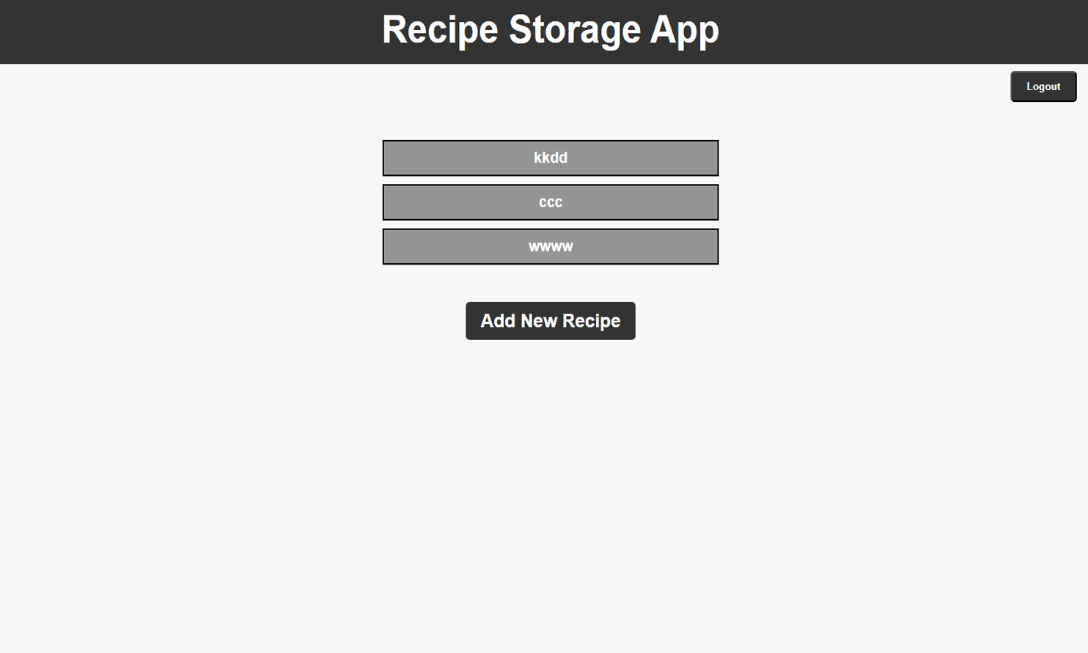
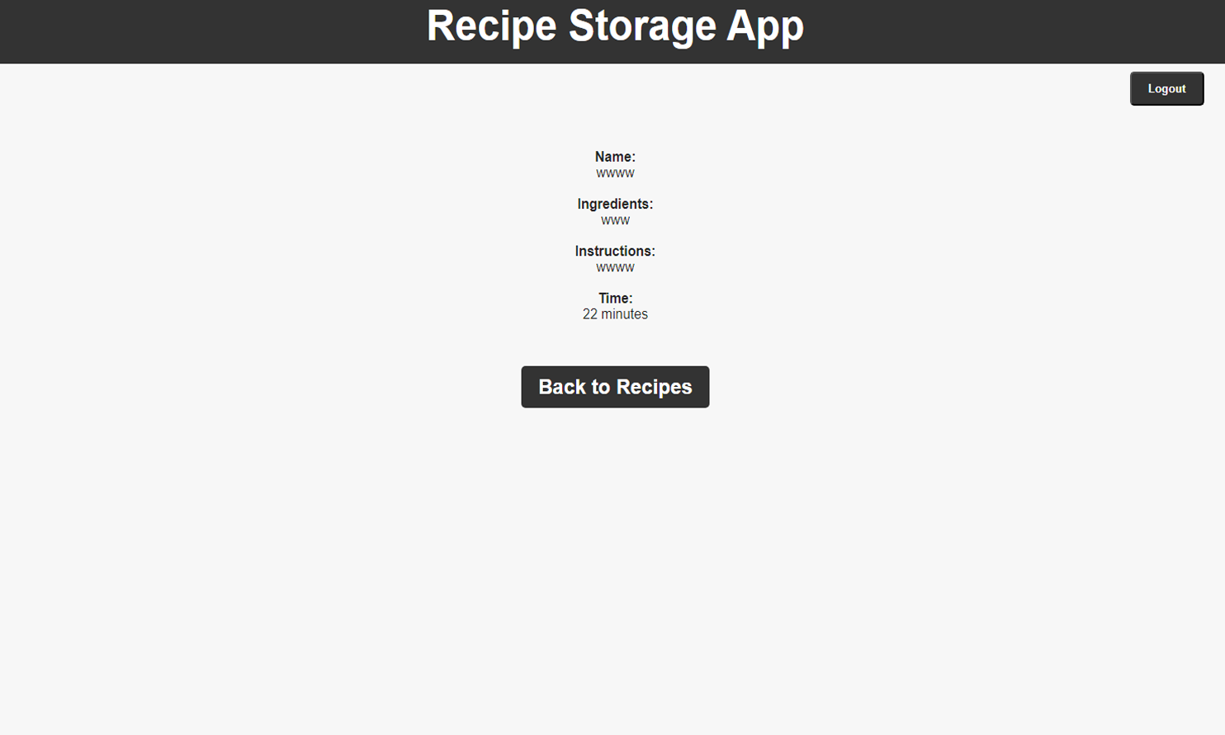
The following screenshots on the right are from the view recipes page, and the page for specific recipes.
The first one, view recipe page, displays all the recipes in the user’s database.
Clicking on the desired recipe will lead to the page at the bottom, where all the recipe details are presented.

Slide 7
Changes From Conception Phase
Added Login with Google option. The reason for logging in with Google instead of the traditional registration process was that it is a much faster and easier option, especially for older people who are not as skilled with registration processes.
Removed the option for adding images, because images take a lot of space, especially since one user would most likely store multiple recipes.

Slide 8
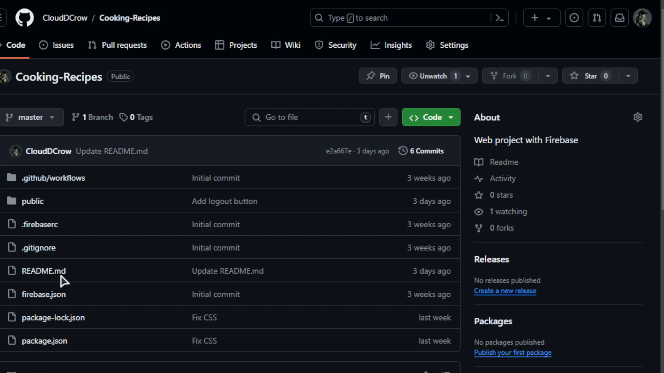
Screencast video

